Slide 1
Infertility
Round Table
University of Amsterdam Sharenet
14 November 2017
Notes:
Logo’s still to be added

Slide 2
Objectives
Infertility Round Table
To put infertility higher on the SRHR agenda
To formulate concrete steps to integrate infertility in (SRHR) programmes and policies

Slide 3
Sharenet Small Grant
Involuntary childlessness: Enhancing knowledge and awareness in the Global South
    To increase awareness amongst various stakeholders about infertility and childlessness in Kenya, Ghana and ‘worldwide’
    To generate and disseminate new insights about experiences and needs of people with fertility problems and (possible) interventions
Notes:
This Round Table is the final step of a Small Grant that we received from Sharenet
The Sharenet Small Grants Fund provides funding for initiatives generating knowledge and coming up with innovations in the field of SRHR

Slide 4






Staff: Dr. Rosemond Hiadzi
Prof. Dr. Ernestina Donkor
Students: Esther Abedu, Deborah Baiden, Charles Yajalin
Staff: Dr. Tammary Esho
Students: Benjamin, Sarah Migiro, Solomon Mwenda
Staff: Dr. Trudie Gerrits, Dr. Henny Bos
Dr. Floor van Rooij
Students: Anna Jansen, Luca Koppen, Evelien Oomen, Mara van Stiphout, Margot Visser, Bilajbegović, Aida Aida Bilajbegovic
Nana Yaw Osei
Dr. Wanjiru Ndegwa
Prof. Dr. Willem Ombelet
Jan Goossens

Slide 5
Activities
Studies: Quantitative and qualitative studies in Ghana and Kenya
    Interdisciplinairy
    Clinics & support groups for people with fertility problems
    Students & staff
Workshops: Disseminating and discussing results amongst practioners and infertility support groups in Kenya (Dec 2016) and Ghana (Nov 2017)
Round Table: Meeting with Experts in the Netherlands
Notes:
Today we are not going to provide the study findings, but we do want to share some of the

Slide 6
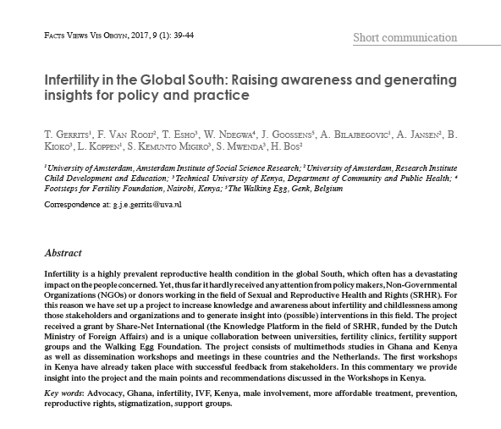
http://www.fvvo.be/assets/658/06-Gerrits.pdf
Notes:
We are not going to share the study findings in this session. More information about the small grant you can find in this article.

Slide 7
Recommendations
Kenya Infertility Workshop
Raise awareness about infertility among Policy Makers, Health Professionals, and NGOs
Tackle stigmatization of infertility
Raise public awareness about male-factor infertility, instead of ‘blaming’ women
Health professionals should provide accurate information (diagnosis and treatment options)
Provide psycho-social and sexual counseling and support
Set up support groups for people facing fertility problems
Address ‘Unmet Need’ for ‘more affordable’ assisted reproductive technologies (ARTs)
Notes:
However, we do want to share the main recommendations that were brought up in the feedback Workshops in Kenya. These may serve as input for todays discussion as well

Slide 8
Setting the scene
Prof. Dr. Jacky Boivin – Quality of life and infertility
Professor of Health Psychology at School of Psychology at Cardiff University.
Dr. Papreen Nahar – The case of Bangladesh.
Research Fellow at the Department of Anthropology, Durham University, UK, and a Research Fellow at School of Health Sciences, Faculty of Biology, Medicine and Health, University of Manchester.
Dr. Willem Ombelet, MD – Making fertility care available and accessible to a much larger proportion of the population
Founder of the Walking Egg foundation (tWE) and Coordinator of the Special Interest Group “Global and Socio-Cultural Aspects of Infertility’ at the European Society of Human Reproduction and Embryology (ESHRE).

Slide 9
Panel
Dr. Ian Askew, Director of Department of Reproductive Health and Research, WHO
Dr. Roy Farquharson, Chairman ESHRE (European Society of Human Reproduction and Embryology)
Yuri Ohlrichs, sexual health educator, Rutgers

Slide 10
Questions for panelists
What does your organisation - respectively the Dutch NGO Rutgers, the WHO and ESHRE - actually do to address the issue of infertility?
What else could be done? By your organisation and/or others?
Who could / should take up this issue further?

Slide 11
Scenario Plan
Dream – what would you like to see in 20 years’ time regarding infertility as newspaper heading? (headline or title of articles)
What do we need to realize the above mentioned goal?
What are the barriers to realize the above mentioned goal?
How can you overcome those barriers and by whom?

Slide 12

Round Table Meeting on Infertility

Slide 13


      Setting the stage
      Developing “An Action Plan” in 4 steps

Slide 14


Slide 15


    Dream – What would you line to see in 20 years time regarding infertility as newpaper heading
    Reformulate this dream in terms of “objectives” for an action plan

Slide 16


Slide 17

      What do you need to realize this goal/objectives?
      Formulate this in terms of “tasks”(what you need to do to achieve the objectives)
      Describe the resources you need for these “tasks”

Slide 18


Slide 19

      What are the barriers you need to realize these goals/objectives?

Slide 20


Slide 21

      How can you overcome thse barriers and from whom?

Slide 22
      OBJECTIVES: Dream – What would you line to see in 20 years time regarding infertility as newpaper heading
      TASKS: What do you need to realize this goal/objectives?
      BARRIERS: What are the barriers you need to realize these goals/objectives?
      OVERCOME BARRIES: How can you overcome thse barriers and from whom?

Slide 23

OBJECTIVES | TASKS | BARRIERS | OVERCOME BARRIES | WHO

Slide 24


Slide 25
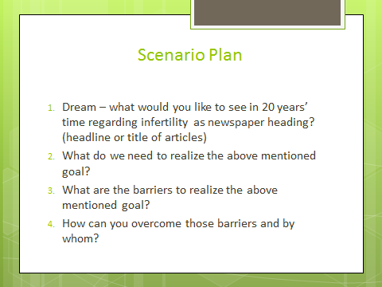
Instructions small groups
Step 2-4 around key theme
Write on flip over
Appoint a rapporteur for plenary reporting after coffee.

